Slide 1
Magnetic Forces
Year 7 Science

Slide 2
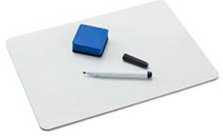
Review
Classify as contact (c) or noncontact (n):
Friction
Gravity
Magnetic
Electrical
2. Draw a down-hill mountain bike, showing all the forces as labelled arrows.

Slide 3
Learning Intentions
Investigating the effects of applying different forces to familiar objects

Slide 4
Success criteria
Describe magnetic force as a non-contact force.
Explain the N and S poles on a magnet.
Draw magnetic fields.

Slide 5


Slide 6

Activity1: Make and test a magnet

Slide 7
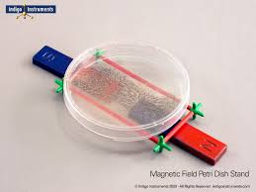
Activity2: Magnetic Field Shapes

Slide 8
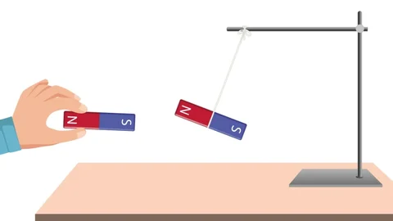
Activity3: Magnetic Forces
Part 1 – Magnetic or non-magnetic
Part 2 – Testing forces between magnets.

Slide 9
Success criteria
Describe magnetic force as a non-contact force.
Classify materials as magnetic or non-magnetic.
Explain the N and S poles on a magnet.
Draw magnetic fields.

